Slide 1
PhD Problem 5
Identify Potential Drug Interactions
Here is where your presentation
Binary Bandits

Slide 2
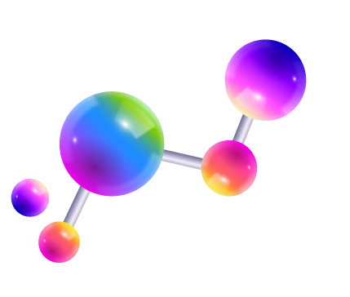


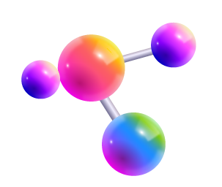
Dominik Soós
David Calano

Slide 3
Problem Overview
Classification of drug interactions / side-effects
Single-target Drug-Target Interactions (DTI)
Multi-target Drug-Drug Interactions (DDI)
SMILES: Simplified Molecular Input Line Entry System
Available datasets:
DrugBank (DDI)
TWOSIDES (DDI)
Open Graph Benchmark (DDI)
BioSNAP (DTI)
BindingDB (DTI)
DrugCombDB
Potential Models:
Convolutional Neural Network
Graph Neural Network
Knowledge Embedding

Slide 4
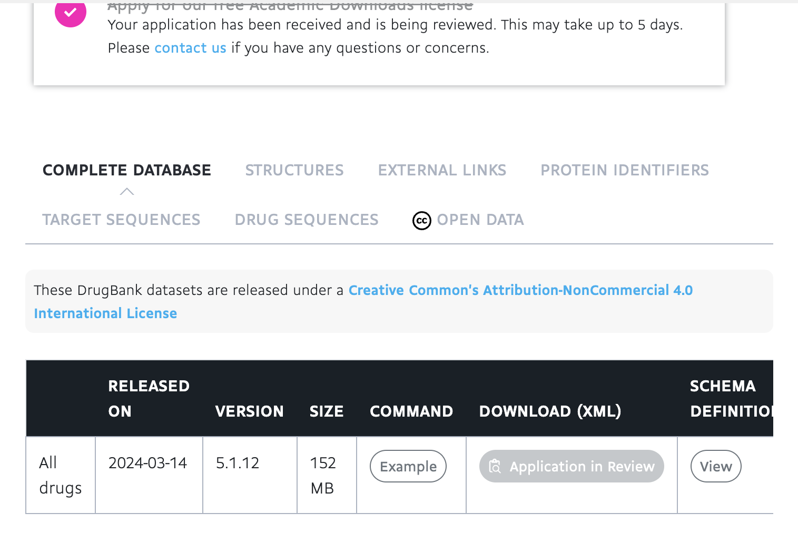
Initial Issues
01
02
03
Data Access
Unbalanced Data
Reference Libraries
04
Technical
Full DrugBank dataset requires subscription
Some available data is highly unbalanced
Recent but aging or unsupported libraries
Environment and hardware-specific issues

Slide 5
Feature Selection
Molecular bondings
Jupiter
Single, Double, Triple, Aromatic
Molecular properties
Jupiter
Ring presence, conjugations
Atomic number, degree, formal charge, hybridization, hydrogen count
Atomic properties
Jupiter

Slide 6
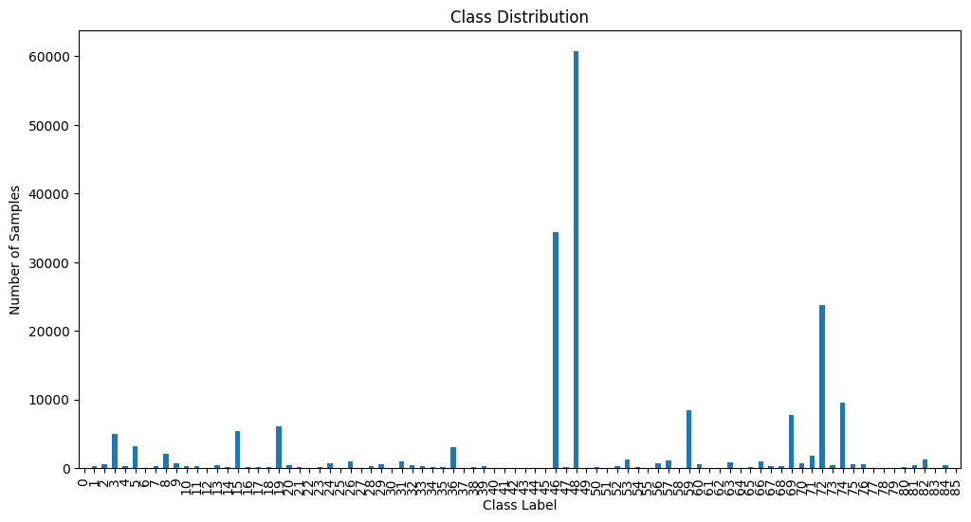
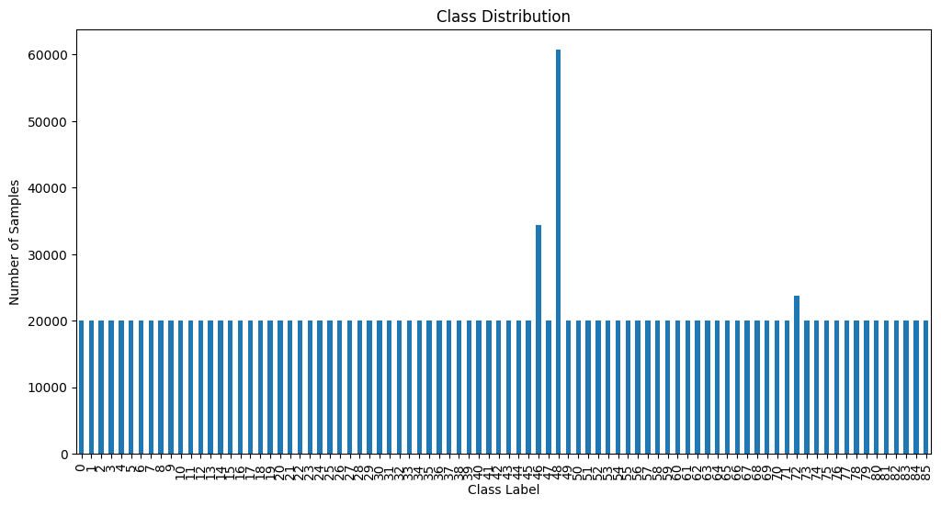
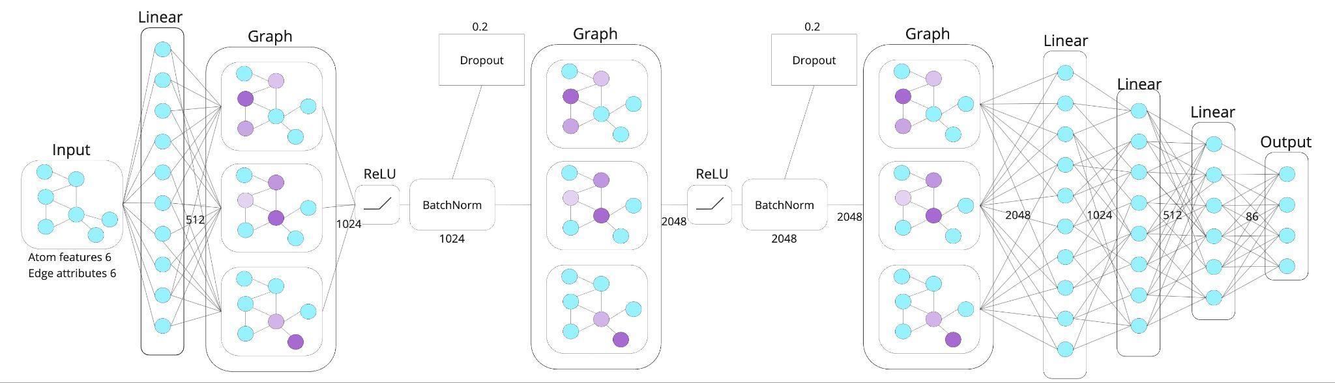
Approach
Data Preprocessing
Feature Selection
CCC(=O)N(C1CCN(CC1)CCC2=CC=CC=C2)C3=CC=CC=C3

Slide 7
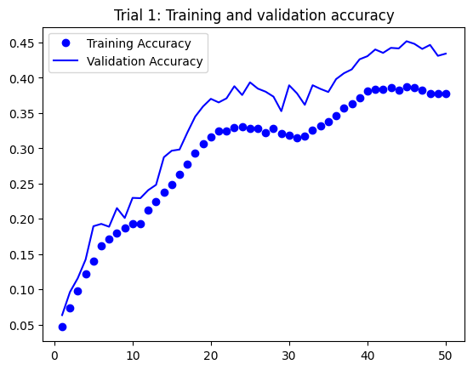
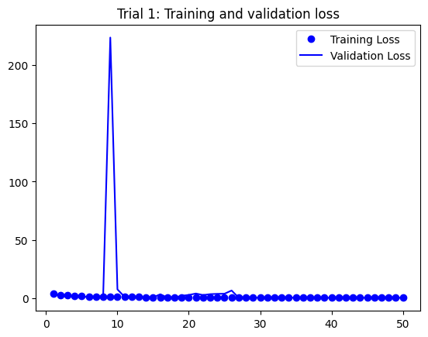
DrugBank Trial 1

Slide 8
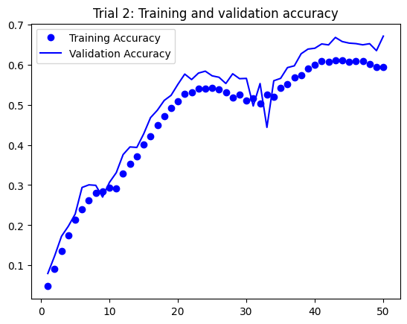
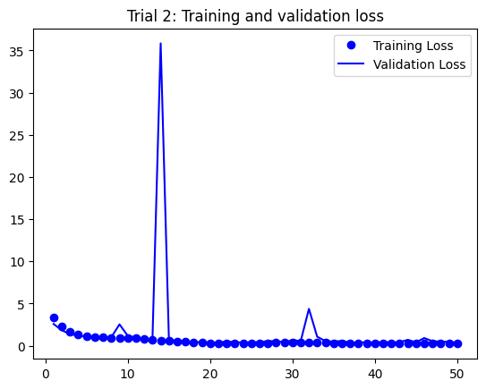
DrugBank Trial 2

Slide 9
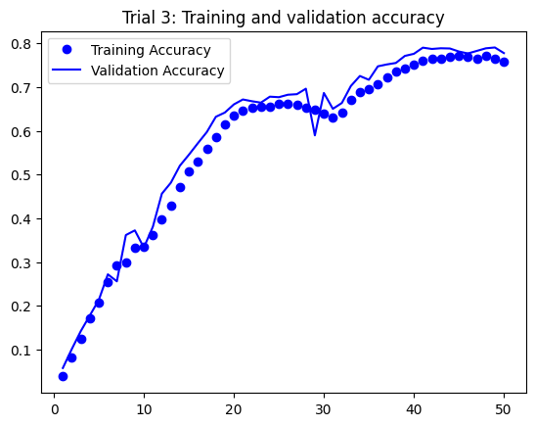
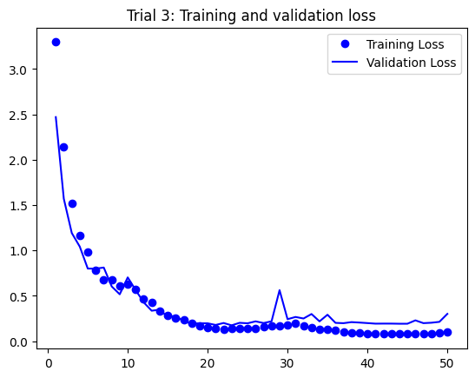
DrugBank Trial 3

Slide 10
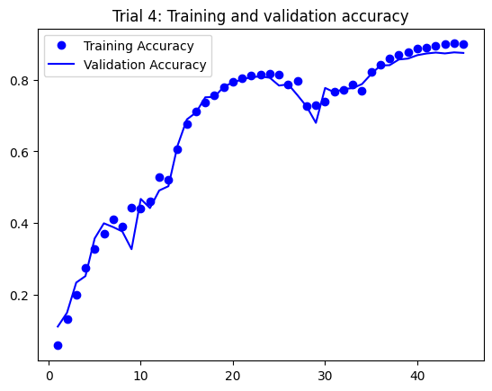
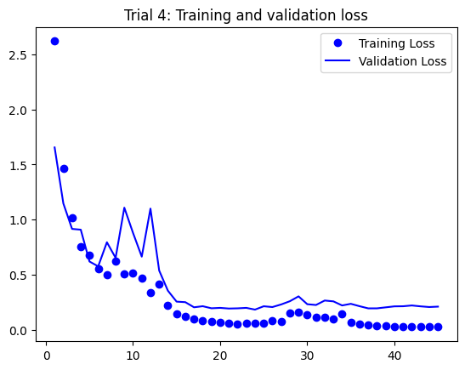
DrugBank Trial 4

Slide 11
DrugBank Trials
Trial | Batch Size | Hidden Parameters | Accuracy (Validation)
1 | 32 | 128 | 43.43%
2 | 128 | 512 | 67.09%
3 | 512 | 2048 | 77.78%
4 | 1024 | 4096 | 87.48%
Notes:
In summary here is a compilation of the trials

